Slide 1
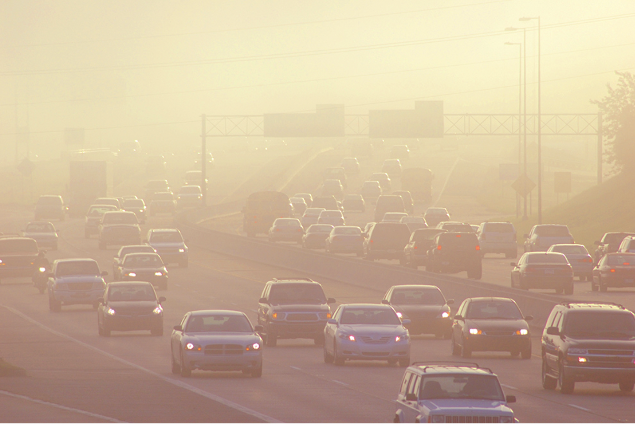
Environmental Justice
Urban Air pollution
Environmental Science
Learning Goal: Investigate environmental justice, climate change, and air pollution through the lense of data science.

Slide 2
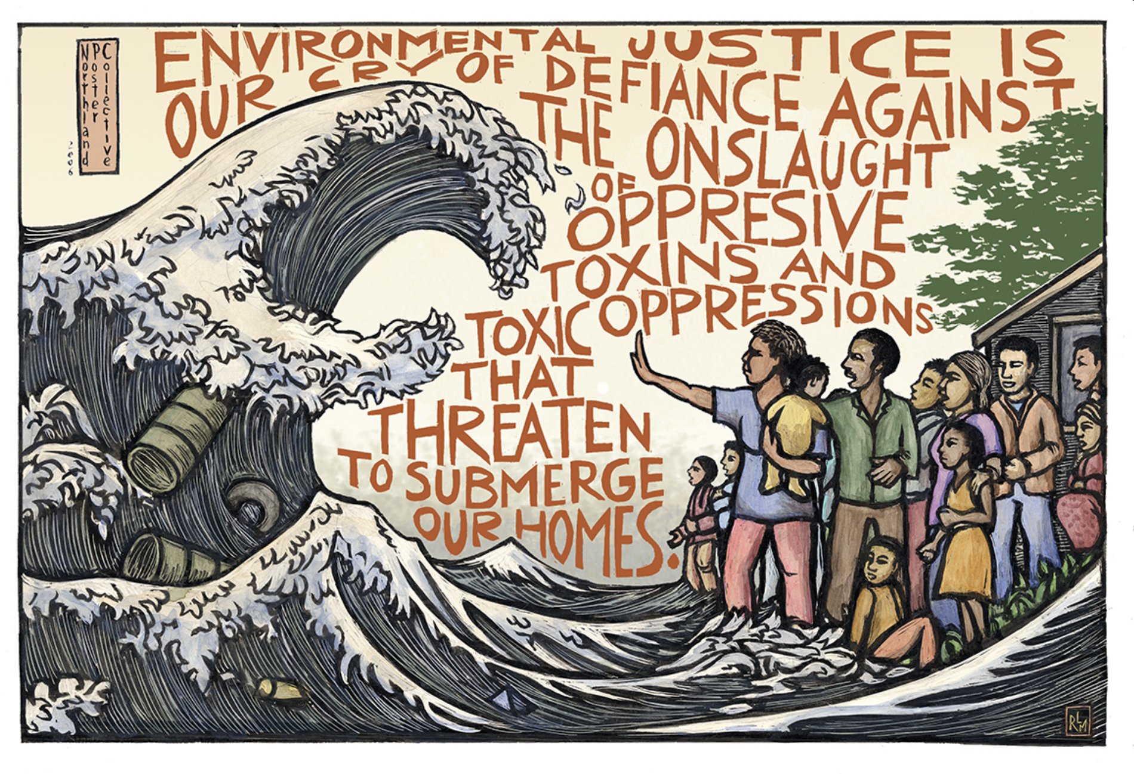
Essential Questions
What is air pollution?
What is environmental justice?
How is pollution related to inequality?
How can maps and graphs help us see where injustice exists?

Slide 3
Engaging
Introduction to air pollution
What is air pollution?
Types of air pollution
Air Quality and Climate Change
How does air quality affect our community?
How do vehicle emissions affect health?
Analyzing urban air quality: Introduction of BEACO₂N sensors
Showcase of BEACO₂N sensors:
How did the Covid-19 shutdown impact the Bay Area air quality?
How can we analyze BEACO₂N data?
Environmental Justice
Inquire Activity: What does environmental justice mean?
Reading activity and presentation
The history of environmental injustice in California: Redlining maps
The presence of environmental injustice in California: Exploring vehicle pollution
Lesson Outline

Slide 4
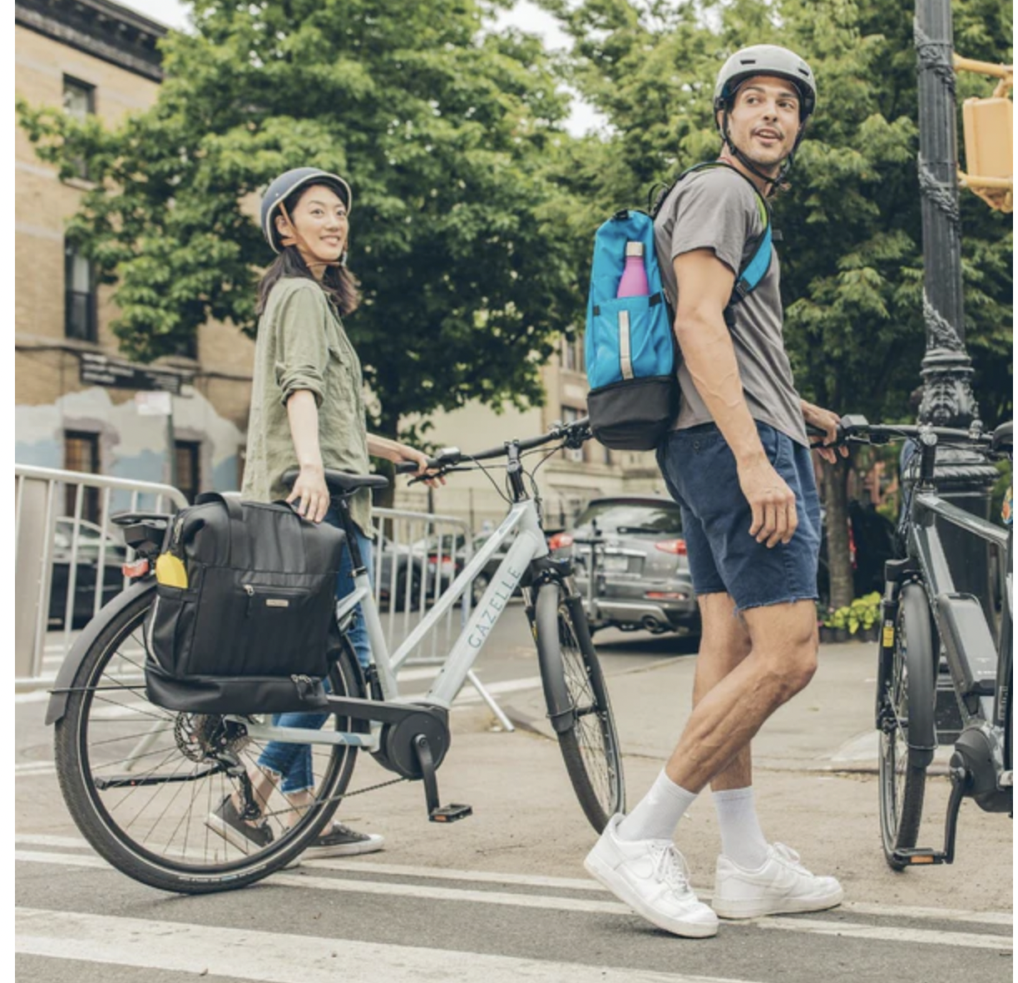
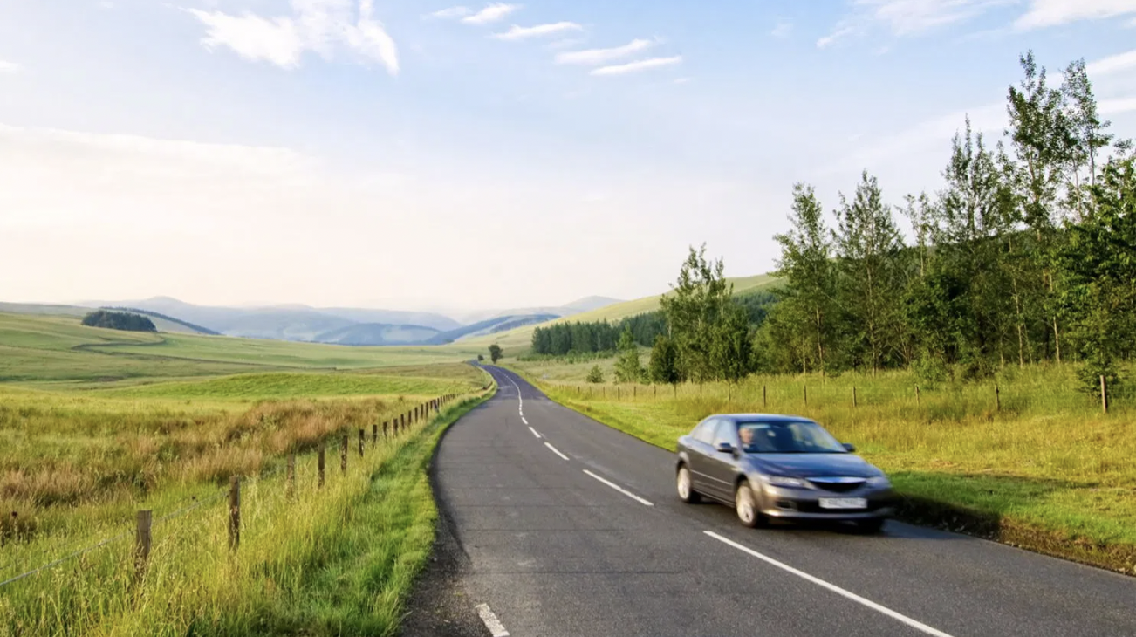
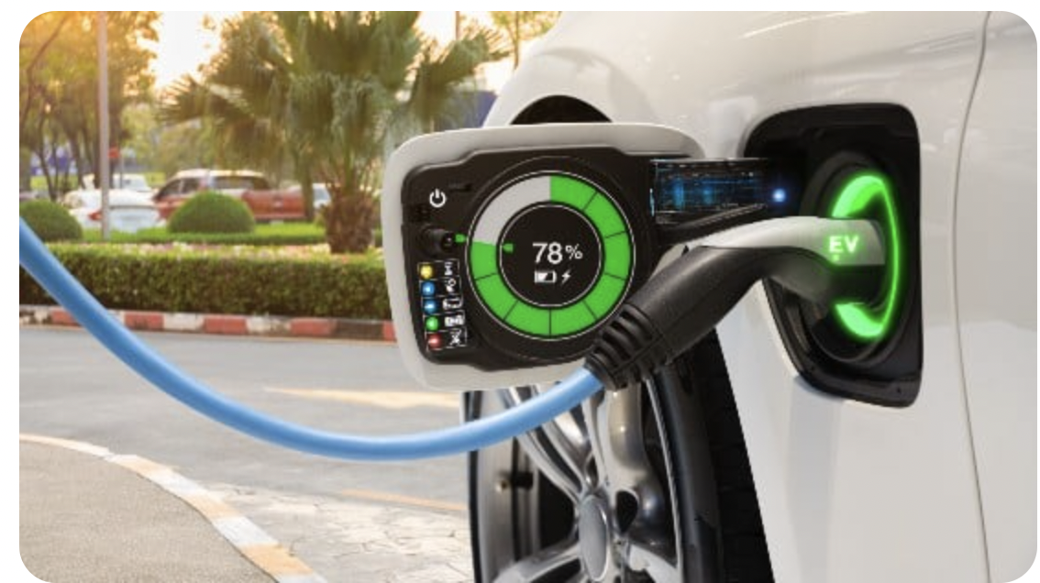
Engaging
In your handout, write a sentence expressing how each image makes you feel.
Image 1
Image 2
Image 3
Image 4
Notes:
Optional Slice

Slide 5
AIR QUALITY
Let’s think about air quality!
a) Do you think the quality of the air in this area is good or bad?
b) How do you know? What evidence is there of air pollution?
c) Have you ever experienced burning eyes, itchy throat, or shortness of breath on polluted days?
d) What time of the year does the air seem dirtiest?

Slide 6
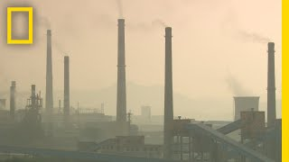
2. Introduction to Air Pollution
As you watch the video, answer the following questions:
What is air pollution?
What are the two main cause of air pollution?
What are the types of anthropogenic air pollution?

Slide 7
Types of anthropogenic pollution
Greenhouse Gases: Gases that trap heat in the atmosphere
In your handout, draw a preliminary model of the greenhouse effect.
Watch the video and refine your model.
Name three examples of greenhouse gases.
Smog: Smog is air pollution that reduces visibility. The term "smog" was first used in the early 1900s to describe a mix of smoke and fog. The smoke usually came from burning coal.
As you watch the video answer the following questions in your notebook
The burning of which fuel is the main source of industrial smog?
Define VOCs and PANs.
Explain the difference between photochemical smog and industrial smog.

Slide 8
Toxic Air Pollutants:
Toxic air pollutants are the pollutants that are known or suspected to cause cancer or other serious health effects, such as reproductive effects or birth defects, or adverse environmental effects. Examples of toxic air pollutants include:
benzene, which is found in gasoline;
perchloroethylene, which is emitted from some dry cleaning facilities; and
methylene chloride, which is used as a solvent and paint stripper by a number of industries.
Extra reading:
Greenhouse Gases:https://www.epa.gov/ghgemissions/overview-greenhouse-gases#overview
Extra videos: https://ww2.arb.ca.gov/emission-types

Slide 9
3. Air Quality and Climate Change
Impacts of Climate Change on Air Quality:
Climate change exacerbates air pollution, leading to increased frequency and intensity of heat waves, wildfires, and extreme weather events. In addition, climate change can worsen local air quality, potentially leading to higher levels of ground-level ozone.
Impacts of Air Quality on Climate Change
Poor air quality contributes to climate change by releasing greenhouse gases and aerosols. Emissions from burning fossil fuels and biomass increase atmospheric concentrations of carbon dioxide and other heat-trapping gases, leading to global warming. Additionally, aerosols can affect cloud formation and alter the planet's energy balance.

Slide 10
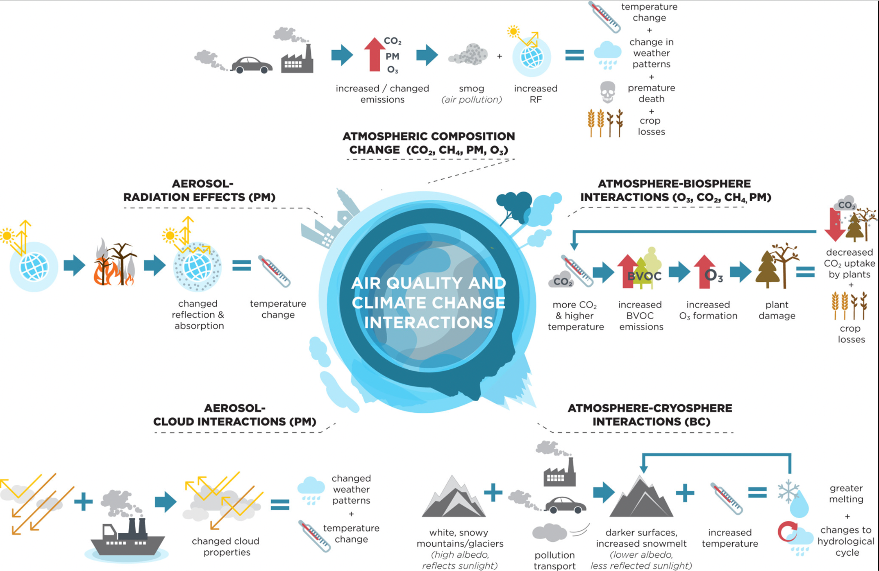
Using the picture below explain in your own words at least two interactions.
Chemistry and the Linkages between Air Quality and Climate Change Chemical Reviews 2015 115 (10), 3856-3897

Slide 11
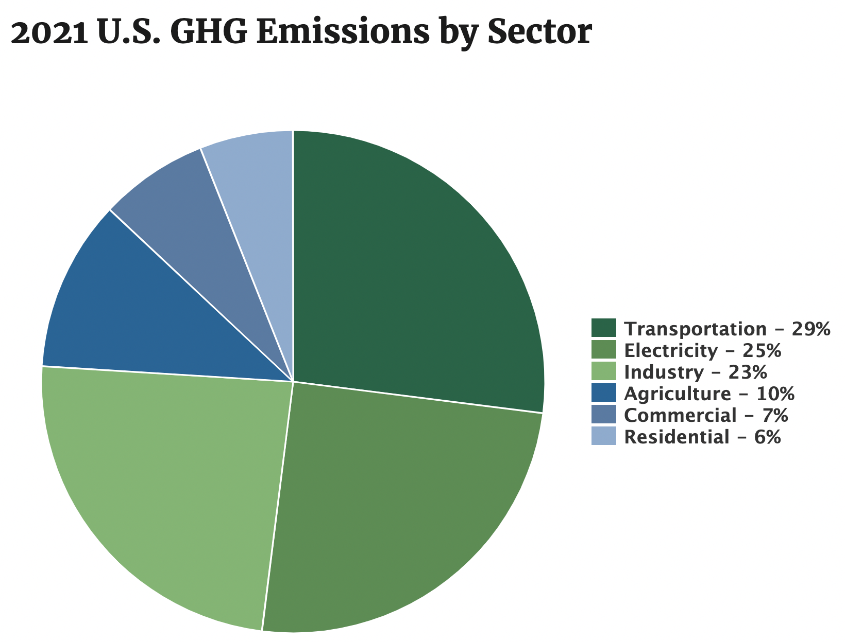
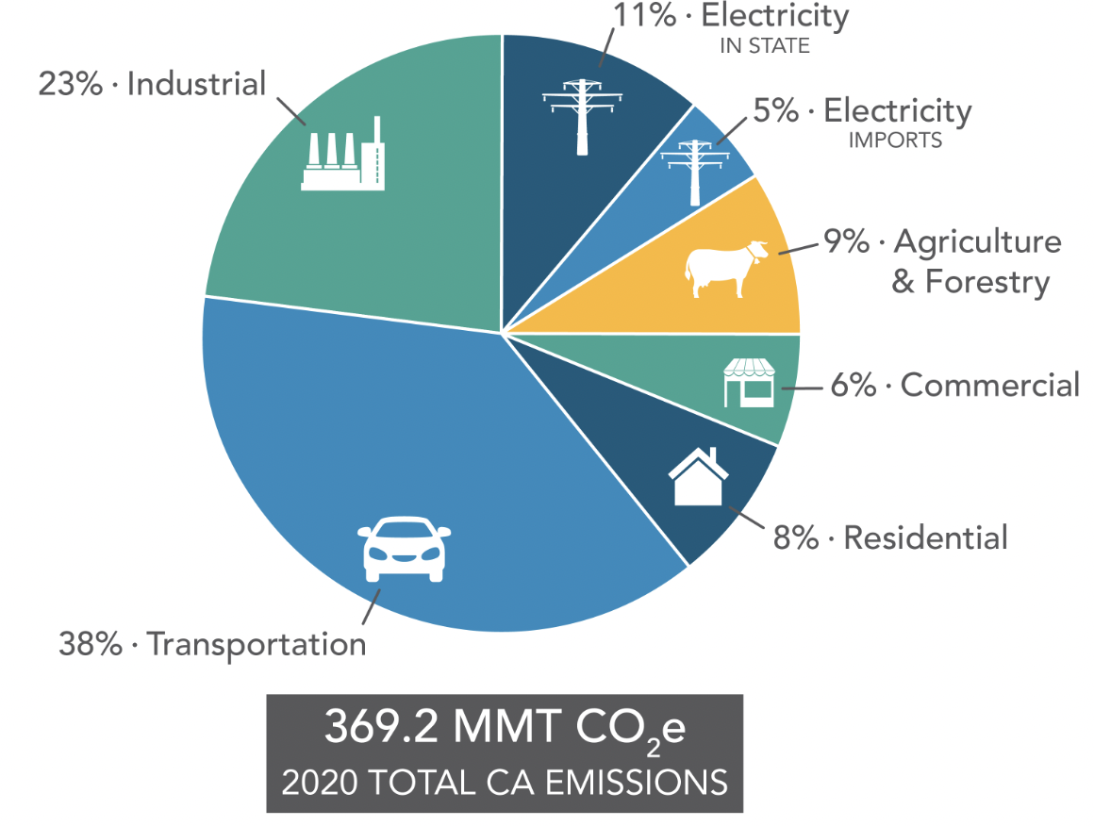
4. How does air quality affect our community?
According to the EPA , the transportation sector is the largest contributor to anthropogenic U.S. greenhouse gas (GHG) emissions
According to California’s Air Resources Board (CARB), 38% of California's greenhouse gas emissions are due to transportation

Slide 12
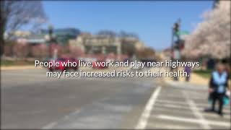
How do vehicle emissions affect health?
As you watch the video, you will answer the following questions:
What leads to vehicle emissions?
How does ozone pollution affect health?
Who are the people most affected by vehicle emissions?

Slide 13
Analyzing local urban air pollution data
BEACO₂N is an innovative approach for monitoring greenhouse gases (GHGs) in urban areas. Instead of relying on a few sensitive instruments, BEACO₂N uses a network of sensors called 'nodes' placed approximately 1 mile (2km) apart. While individual nodes may have lower precision, when combined, they create a detailed map of CO₂ and air pollutants like NO, NO₂, O₃, CO, and PM (particulate matter), providing valuable information about urban air quality.

Slide 14
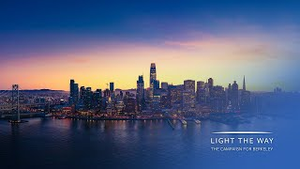
Showcase of BEACO₂N sensors:
How did the Covid-19 shutdown impact air quality in the Bay Area?
As you watch the video, answer the following questions:
What pollutants improved during the Covid shutdown that were talked about in the video?
Select one: What could we use BEACO₂N data to explain?
How many people died during Covid?
Quantifying how much CO₂ emissions are from industry, and how much are from cars?
Write a paragraph explaining what the Covid shutdown did to the Bay Area air quality

Slide 15
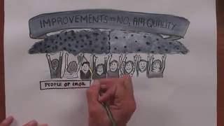
5. Environmental Justice
Inquire Activity: What does environmental justice mean?
In the table, write different synonyms or definitions for the words “environment” and “justice”.
After watching the video, write a paragraph describing the definition of environmental justice.

Slide 16
Definition
According to EPA, environmental justice is the fair treatment and meaningful involvement of all people regardless of race, color, national origin, or income, with respect to the development, implementation, and enforcement of environmental laws, regulations, and policies. This goal will be achieved when everyone enjoys:
The same degree of protection from environmental and health hazards
Equal access to the decision-making process to have a healthy environment in which to live, learn, and work.
https://www.epa.gov/environmentaljustice

Slide 17
Reading activity and presentation
Learning Objectives:
Begin to understand environmental injustice
Learn about ways we can address environmental injustice today.
Understand the benefits and implications of environmental decisions.
In this activity student will be separated in groups of 2-3, read an article about environmental injustice and make a presentation of the reading.
See the activity instructions in page 11 of the handout.

Slide 18
History of Environmental Injustice in California: Redlining Maps
What is redlining? Redlining is a practice through which federal and local governments and financing entities systematically denied public and private financial services to Black and other people of color. This set of practices included both race and environmental factors as criteria in assessing the perceived credit-worthiness of neighborhoods and led to many of the environmental disparities we see affecting communities of color across the state today.
https://storymaps.arcgis.com/stories/f167b251809c43778a2f9f040f43d2f5

Slide 19
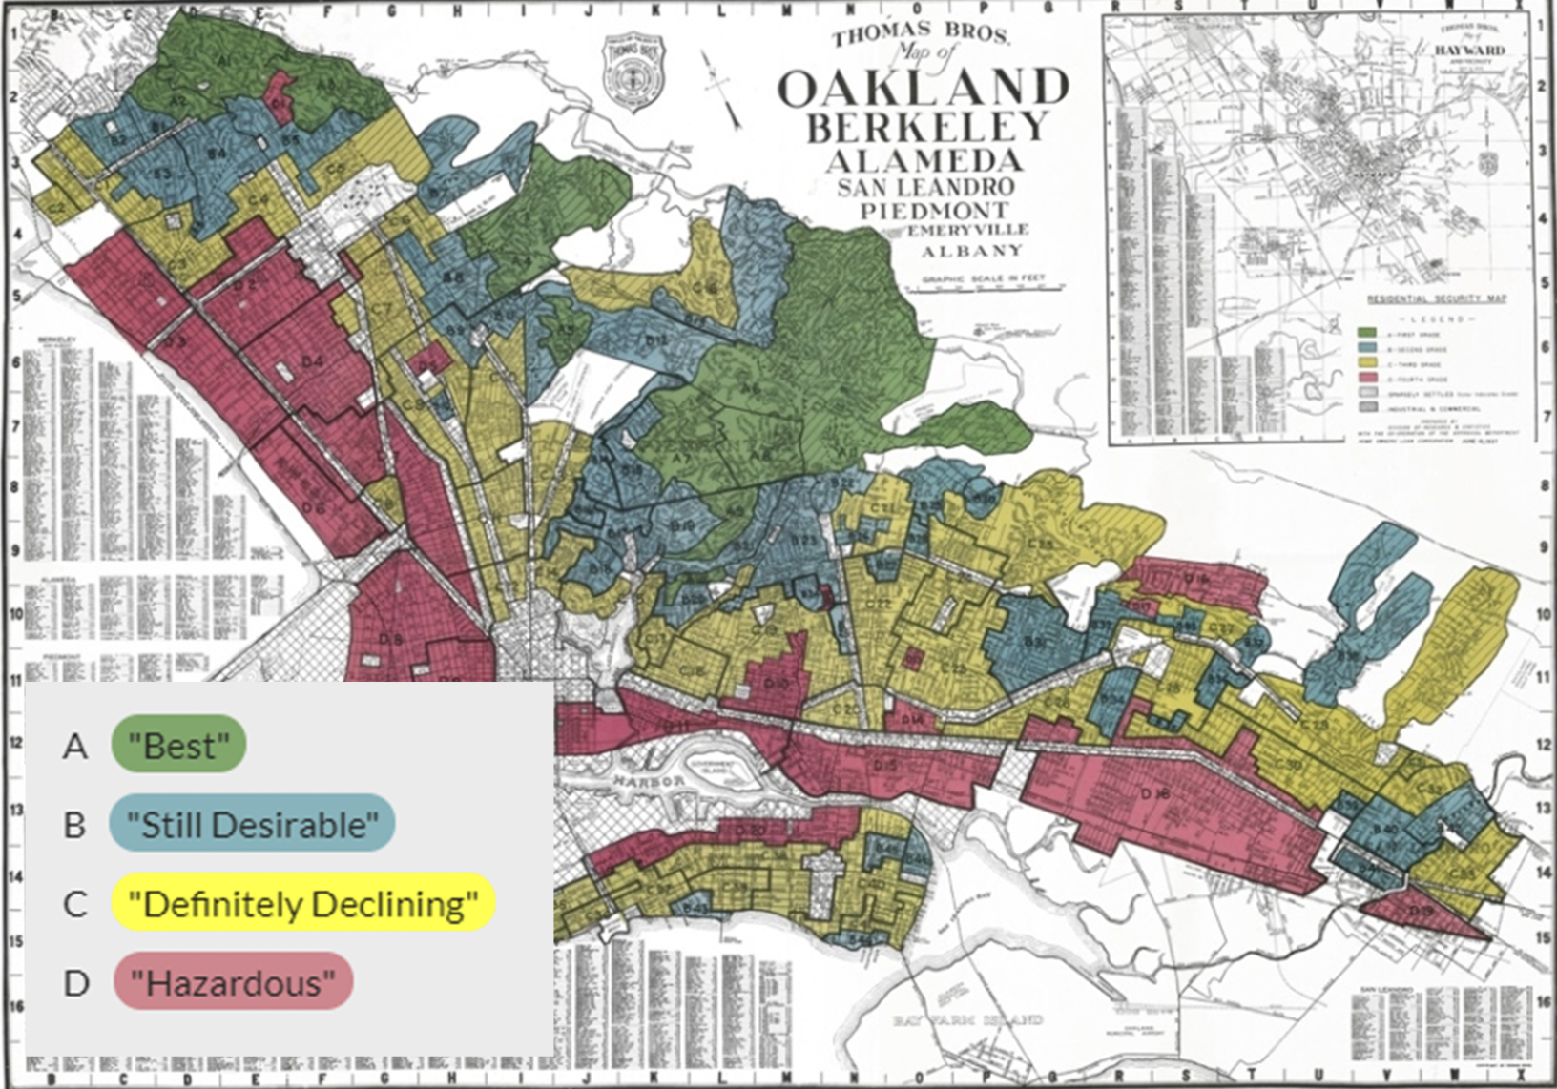
Mapping of Inequality: From Albany to San Leandro
The map from 1937 aimed to show that the area was “secure” enough to guarantee a federal loans. Maps were color-coded. Neighborhoods found to be high risk to lenders were outlined in red, and neighborhoods deemed “declining” were outlined in yellow. The “best” and “desirable” neighborhoods were outlined in green and blue, respectively.
The Mapping Inequality Tool
Click “map options” and then “graded areas” to make it easier to use.
Click on an area and then click “show scan” to see the primary document with the data.

Slide 20
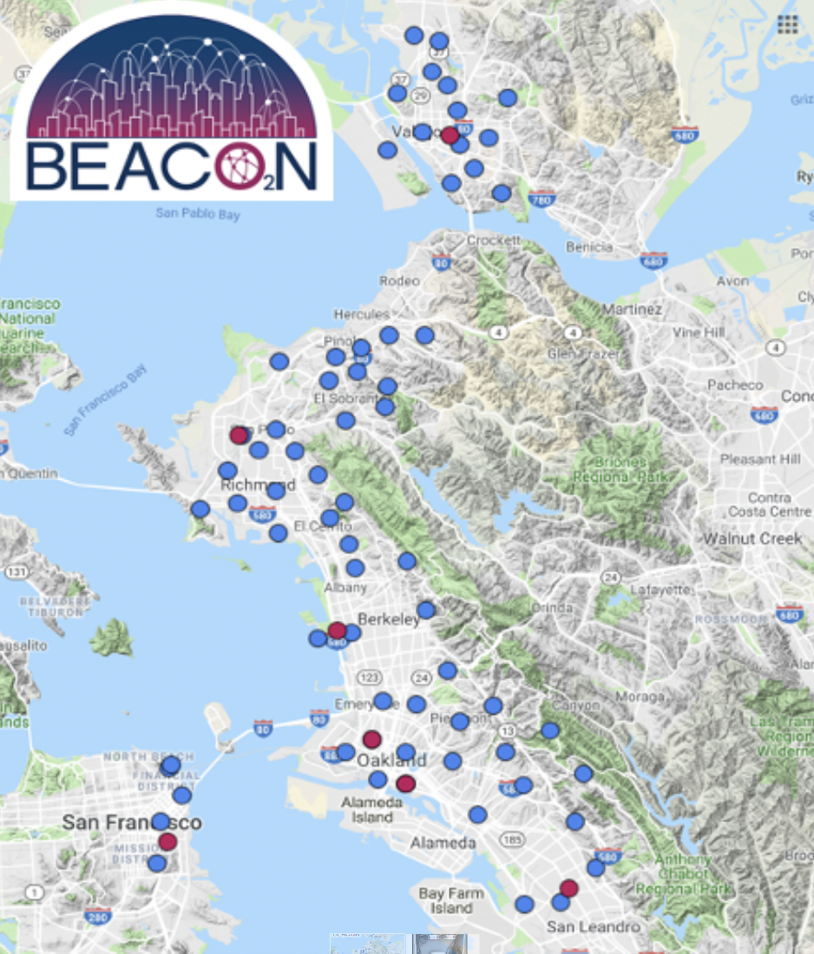
Exploring Vehicle Pollutants
NO_{X} from vehicles is a harmful pollutant causing air pollution, smog, acid rain, and respiratory issues. It is a potent greenhouse gas, impacting climate change. Emission control measures are crucial for air quality.

Slide 21
Using Jupyter notebook, we will visualize the NO_{X} data from BEACO₂N to analyze and identify any trends present.
Download the file from this link and drag it to the folder Air quality in the Jupyter Notebook that you created (slide 16). The file is Highways_and_Pollutants.ipyn
As you go through the file, answer the following questions:
What do you observe in the NO times series graph? How do highways affect NO concentrations?
What observations can be made in the NO₂ time series graph? How do highways influence NO₂ concentrations?
Comparing BEACO₂N data near/far from highways to the redlining map from Albany and San Leandro. Do you think that environmental injustice continues to perpetuate? Write a paragraph explaining your answer.

